Slide 1
we are “TEAM 4”

Slide 2
What is ForCam?
Security and Surveillance System

Slide 3
FEATURES
FIP
Admin only control
AI
Alerts

Slide 4
PLATFORMS
Android
Laptop with Internet connectivity

Slide 5
FUNCTIONS
Surveil
Look for intruders
Alert the user

Slide 6
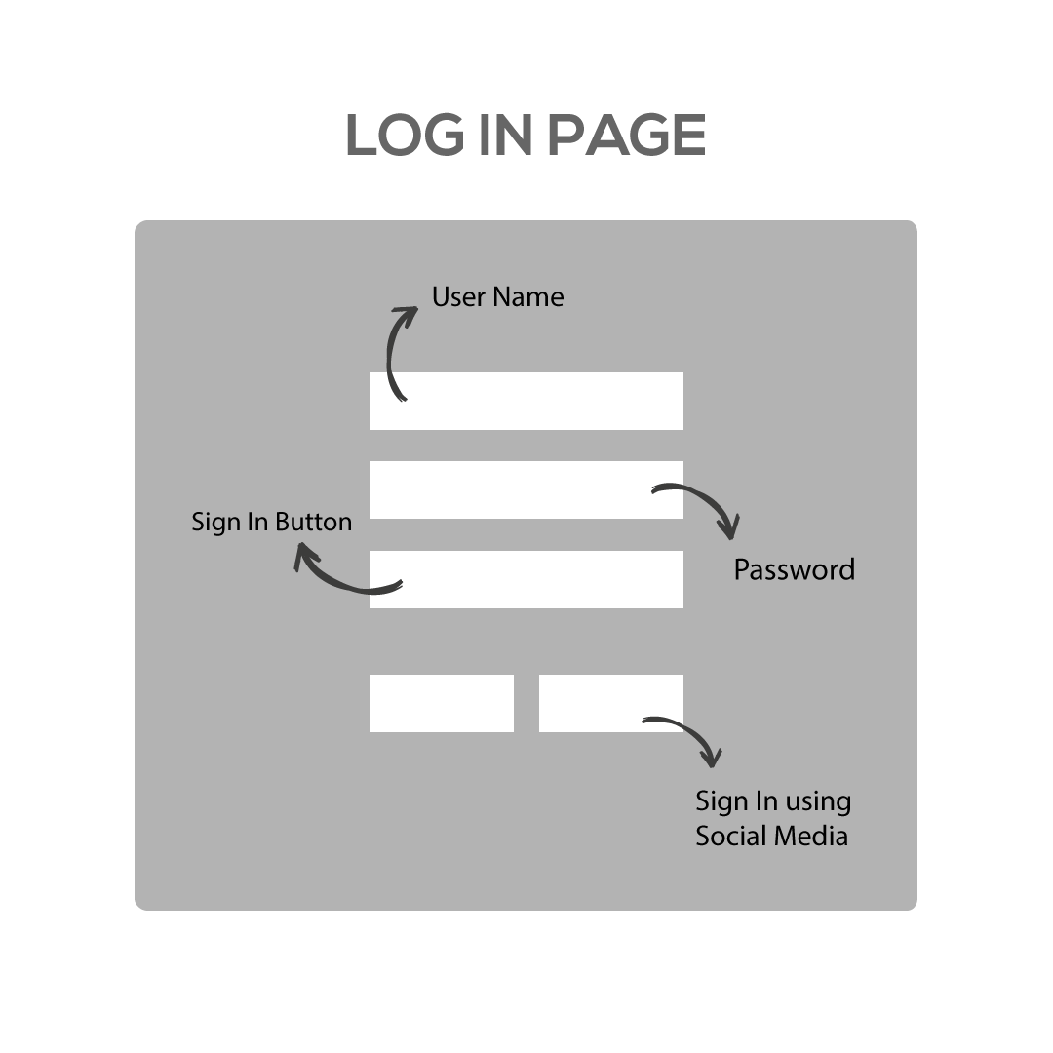
User Interface

Slide 7
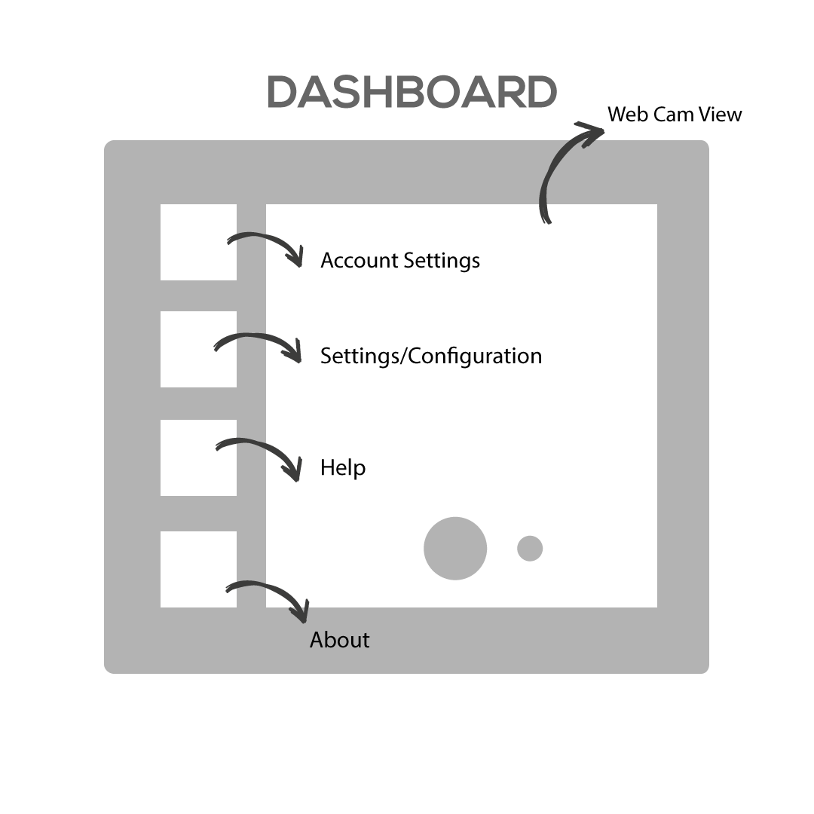
Once you log in….

Slide 8
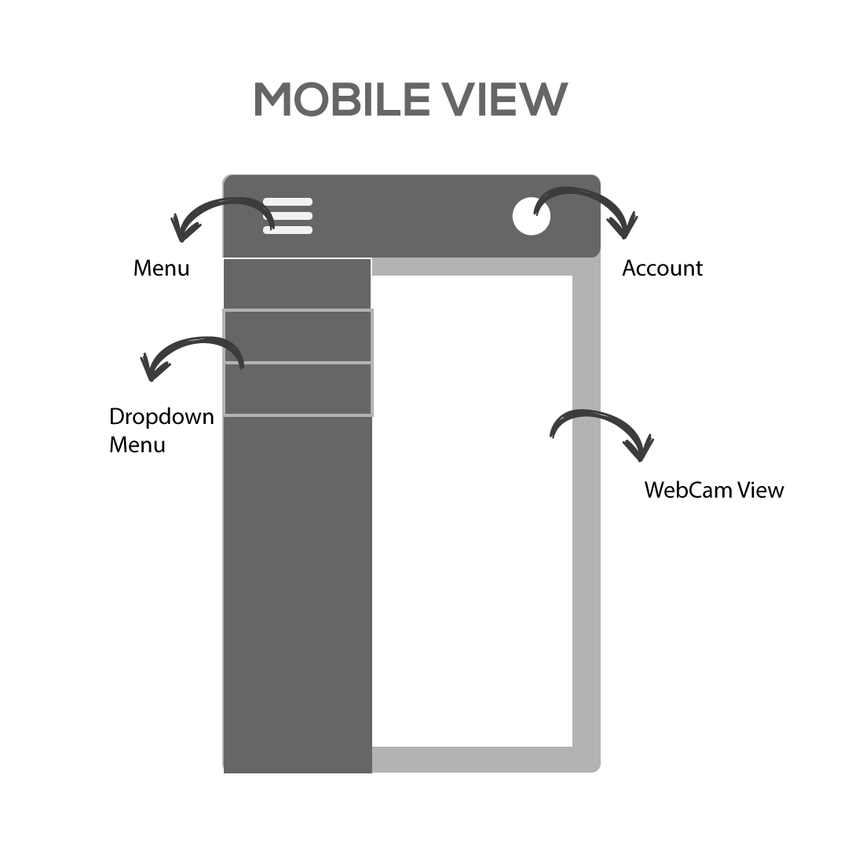
Google’s Material Design

Slide 9
THANK YOU FOR YOUR TIME

